Slide 1
English at Widewell
National Requirements
Reading
Writing (Grammar and Punctuation, Composition, Spelling and Handwriting)
Speaking and Listening
Early Years and Foundation Stage
What can parents do to support their child?

Slide 2
NATIONAL REQUIREMENTS
The National Curriculum changed in 2014.
As an academy we do not have to follow it but we choose to for English and maths because of the Statutory Assessment Tests (SATs) at the end of Year 2 and Year 6.
We constantly assess (both formally and informally) throughout the year so that we can judge the progress and understanding of each child.
Children that need further support are put into small groups for weekly or daily support outside normal lessons.
We provide you with details of your child’s progress in October, February and July. Please contact the class teacher if you have any concerns.

Slide 3
Reading - phonics
We use Read Write Inc. Phonics to teach our pupils to read.
Children are assessed and taught in groups of similar ability.
Phonics is the relationship between printed letters and the sounds they make.
Children will first learn the most common letter sounds, and then look at more difficult patterns such as recognising that ‘ow’ sounds different in ‘cow’ than in ‘low’, or that both ‘ai’ and ‘ay’ make the same sound in different words.
Children’s reading is tested in the Year 1 phonics screening check.
This check will also test nonsense (alien) words such as:
splarck thrime flurp
http://www.oxfordowl.co.uk/for-home/phonics-made-easy
Notes:
Show RWInc phonics books. Link to Oxford Owl.

Slide 4
Reading - comprehension
As children move through school there is a greater emphasis on comprehension. Instead of being able to just decode the words, they begin to understand what the words mean.
In KS2 the children will develop their understanding of whole texts and will be able to draw simple inferences about characters or events in a story.
We use a variety of books in our reading scheme and these are all ‘book banded’. The children move through the colours until they become ‘free-readers’.
We encourage all children to read a range of fiction, non-fiction, poetry, plays and reference books.
Notes:
Show reading scheme books

Slide 5
Reading for Enjoyment
MOST IMPORTANTLY – WE WANT ALL CHILDREN TO ENJOY READING.
Whatever age you think you should stop reading bedtime stories, double it!
Listen to your child read as often as possible.
Sharing the book is a positive experience.
Discuss the text. What did they like? Who is their favourite character? What could happen next?
Please do this even if you haven’t listened to them read.
Reading should be something every child chooses to do – not a negative experience or a punishment!
Our library can be accessed from home.

Slide 6
Writing - Grammar and Punctuation
Testing in year 6 was introduced in 2013.
Year 2 pupils will also have SATs tests from 2016 onwards.
See example test papers
G & P is taught throughout school and each year the children learn new elements of each. They also consolidate what they have learnt in previous years.
For example, in year 1 they learn about nouns but by year 6 they understand abstract, proper, common, collective and plural nouns.
Notes:
Show test papers and ask some questions

Slide 7
It is important that children learn about the parts of speech in context
The earth is round. (Adjective) The boys ran round the tree. (Preposition) Will you come round to our house this evening? (Adverb) We won the first round of the tennis cup. (Noun) The child’s eyes rounded with excitement. (Verb)

Slide 8
Example questions – KS2 test
Rewrite the sentence below so that it begins with the adverbial.
We turned off the lights before we left.
Circle all the determiners in the sentence below.
There wasn’t much juice left in the fridge, so I bought a new bottle.
Circle the relative clause in the sentence below.
The blue car that was parked outside the shop was for sale.

Slide 9
It is important to remember that punctuation saves lives!
Let’s eat grandpa.
Let’s eat, grandpa.
And we all know the story of the panda who walks into a bar. He eats, shoots and leaves.
OR
Does he eat shoots and leaves?

Slide 10
Writing - composition
Children who enjoy reading tend to be more confident when writing.
Children are taught to write in a variety of ways. We start by showing them examples of the text they will end up writing (e.g. a newspaper article or a fairy tale). We build up bit by bit until the children are able to produce their own work.
This ‘build-up’ will include work on, for example, sentence structure, introductions, paragraphs and punctuation.
Over the years at Widewell, children will learn about a variety of different forms of writing, for example, play scripts, instructions, letters, reports, stories, poems and recounts.
Editing and improving work is tricky but the children need to develop these skills (we cannot always rely on spell-check!).

Slide 11
Examples of Writing Skills – Year 1
• Hold a pen or pencil in the correct and comfortable way
• Name the letters of the alphabet in order
• Write lower-case letters starting and ending in the right place
• Write capital letters, and the digits 0 to 9
• Spell simple words containing the main sounds they’ve learned in reading
• Spell the days of the week
• Learn to write words with common endings, such as –ed, –ing, –er and –est
• Plan out sentences aloud before writing them
• Write simple sentences, and those using joining words such as ‘and’
• Begin to use full stops and capital letters for sentences
• Combine some sentences to make short descriptions or stories

Slide 12
Examples of Writing Skills – Year 6
• Identify the audience and purpose before writing, and adapt accordingly
• Select appropriate grammar and vocabulary to change or enhance meaning
• Develop setting, atmosphere and character, including through dialogue
• Write a summary of longer passages of writing
• Use advanced organisational and presentational devices, such as bullet points
• Use the correct tense consistently throughout a piece of writing
• Use expanded noun phrases to convey complicated information concisely
• Use grammatical connections and adverbials for cohesion
• Use ellipses, commas, brackets and dashes in writing
• Use semi-colons, colons and dashes between independent clauses

Slide 13
Writing - Spelling
We are always looking for new and improved ways to teach spelling.
Currently, each year group is teaching the spelling rules and conventions from our school Spelling Progress Chart. This was developed in line with the NC2014.
Every week a new spelling rule is introduced. It is taught in class and the children are given words to learn for a test.
Some classes are trialling a new system of testing where the pupils are given the spelling rule but are told to find examples of this.
It is important that the children do not just learn the spelling words but that they try to remember the spelling rule.

Slide 14
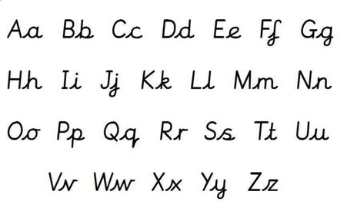
Writing – handwriting We use cursive handwriting and this is taught from Foundation. The children lead in to each letter which helps when they begin to join letters together. Capital letters are never joined.

Slide 15
Speaking and Listening
Children are given plenty of opportunities to improve their speaking and listening skills:
Drama during English or Topic lesson
Through questioning by adults or pupils
Classroom debate and discussion
Assemblies
Youth Speaks
School Parliament
Meeting visitors to the school
Subject presentations
Group reading and Paired reading
Circle time and PSHE discussions
Show and Tell

Slide 16
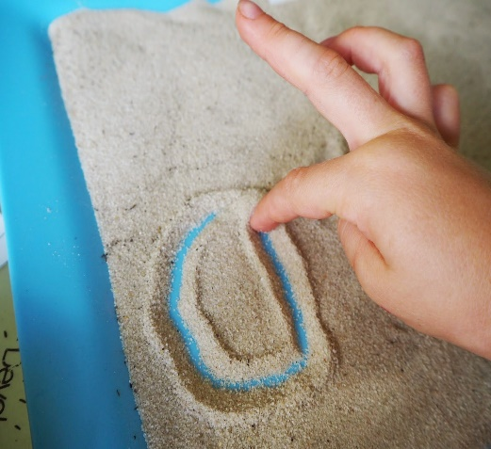
Early Years and Foundation Stage
Nursery and Foundation are taught initial sounds and concentrate their activities on that sound. For example, when learning about ‘b’ they will look at a variety of things that begin with that sound. A ‘sound bag’ will contain books, bananas, bowls, birds and a box.
In Foundation the children start to blend.
Circle time, games, writing activities (mark making) will all focus on that sound.
Lots of learning through experiences, games and playing.
Literacy is mainly taught through topic work.

Slide 17
How can you support your child at home?
Listen to them read as often as possible.
Ask lots of questions about the books they are reading.
Enjoy books with them.
Get them to read a variety of texts (newspapers, instructions for games, menus, road signs, names of shops, fairy tales, information booklets, websites etc).
Support them with their homework but do not do it for them!
Help them to learn the spelling rule for the weekly test.
Encourage your child to use cursive script when writing at home.
Keep a dictionary handy (they tell you a lot).
Encourage dinner time debate and discussions.
Get in touch with the class teacher if there are any concerns.

Slide 18
Useful Websites
www.gov.uk/government/publications/national-curriculum-in-england-framework-for-key-stages-1-to-4
http://widewellprimary.eschools.co.uk/website
http://www.bbc.co.uk/education
www.readwriteinc.com (phonics and other areas of English)
http://www.oxfordowl.co.uk/for-home/phonics-made-easy (phonics)
www.bigbrownbear.co.uk (online/interactive games)
www.crickweb.co.uk (free online games and activities)
www.woodlands-junior.kent.sch.uk (lots of useful English activities)

